Slide 1
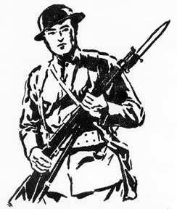
U.S. Entry into the War

Slide 2
Objectives
Analyze how the American government mobilized the public to support the war effort.
Explain why the United States entered the conflict on the side of the Allies.

Slide 3
Terms and People
Selective Service Act – law that established a military draft in 1917
Bernard Baruch – head of the War Industries Board, which regulated businesses related to the war effort
CPI – Committee on Public Information, which worked to convince the public that the war was just
George Creel – director of the CPI

Slide 4
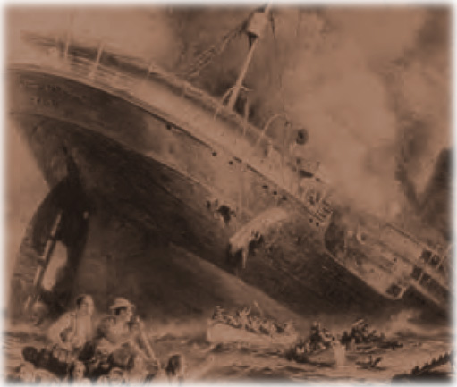
What caused World War I, and why did the United States enter the war?
German U-boats torpedoed ships bound for Britain.
On May 7, 1915, a U-boat sank the British passenger ship Lusitania off the coast of Ireland, killing many Americans.

Slide 5
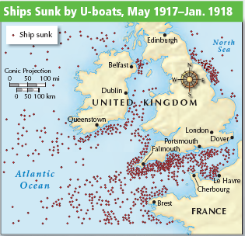
Americans were angry about the Lusitania. Germany failed to keep its promise to not sink any more passenger ships.
President Wilson still wanted peace, but he began to prepare for the possibility of war.
In 1916, Congress expanded the army and authorized more warships.

Slide 6
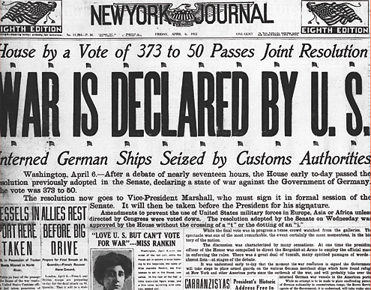
Two events in 1917 led President Wilson to ask Congress to declare war on the Central Powers.
The Zimmermann Note was intercepted. In this telegram, Germany tried to forge an alliance with Mexico against the United States.
Germany returned to a policy of unrestricted submarine warfare, sinking any ship headed for Britain.
On April 2, 1917, Wilson asked Congress to declare war against Germany, saying “The world must be made safe for democracy.”

Slide 7
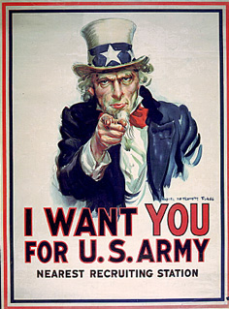
In 1917, the United States needed to increase the size of its army.
President Wilson called for volunteers.
Congress passed the Selective Service Act.
More than 4 million U.S. soldiers were sent to Europe.

Slide 8
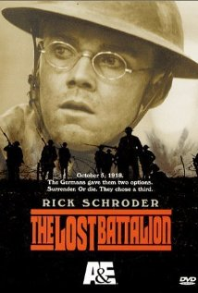
The Lost Battalion
Follows the 308th, 77th Infantry Division as roughly 500 men get cut off by German forces in the Argonne forest.
Major Charles White Whittlesey attempts to save his men and complete his mission.
Your task: Write down 6 facts about WW1 you see through this movie each day we watch.

