Slide 1
The Second New Deal
1935-1939

Slide 2
OBJECTIVES
Discuss the programs of social and economic reforms in the second New Deal.
Explain how New Deal legislation affected the growth of organized labor.
Describe the impact of Roosevelt’s court-packing plan on the course of the New Deal.

Slide 3
VOCABULARY
pump priming – economic theory that favored public-works projects because they put money in the hands of consumers who would buy more goods, stimulating the economy
Social Security Act – 1935 law that created a pension system for retirees, established unemployment insurance, created insurance for victims of work-related accidents, and provided aid for poverty-stricken mothers and children, the blind, and the disabled
Wagner Act – law that recognized the right of employees to join labor unions and gave workers the right to collective bargaining

Slide 4
VOCABULARY
collective bargaining – process in which employers negotiate with labor unions about hours, wages, and other working conditions
Fair Labor Standards Act – law that set a minimum wage and a maximum workweek and outlawed child labor
court packing – FDR plan to add more justices to the Supreme Court after the Court ruled some New Deal legislation unconstitutional

Slide 5
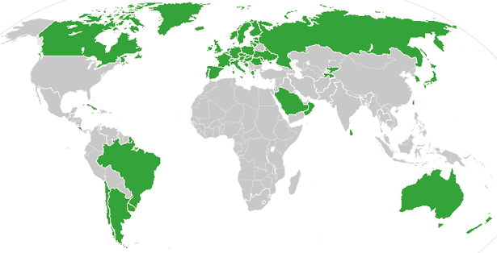
Universal Healthcare
http://www.cnn.com/2012/06/28/health/countries-health-care/index.html

Slide 6
What is special about the Second New Deal?
1) As depression continued to grip the nation, Roosevelt continued to search for solutions.
2) Many of the New Deal programs created by FDR continue to impact Americans today.

Slide 7
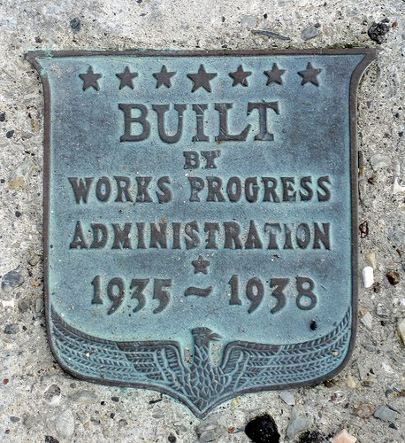
Though progress had been made toward easing the problems of the Great Depression, Roosevelt knew that much work still needed to be done.
In 1935, FDR launched a new campaign to help meet the goals of relief, recovery, and reform.

Slide 8
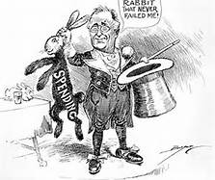
As FDR planned a new round of spending, critics charged that New Deal programs, and their high price tags, were wasteful.
The government was spending money it did not have.
The federal deficit had soared to $4.4 billion.
Economists such as John Maynard Keynes disagreed.
Consumer spending would stimulate the economy.
Deficit spending was needed to end the depression.

Slide 9
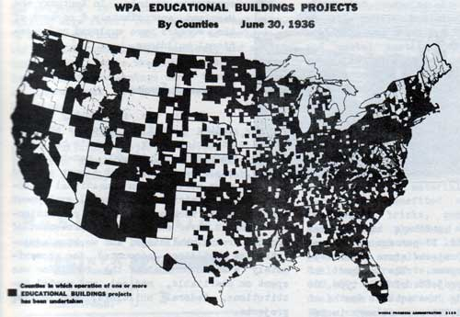
Workers built highways and public buildings, dredged rivers and harbors, and promoted soil and water conservation.
Artists were hired to enhance public spaces.
The Works Progress Administration (WPA) created millions of jobs on public-works projects.
http://livingnewdeal.berkeley.edu/map/

Slide 10
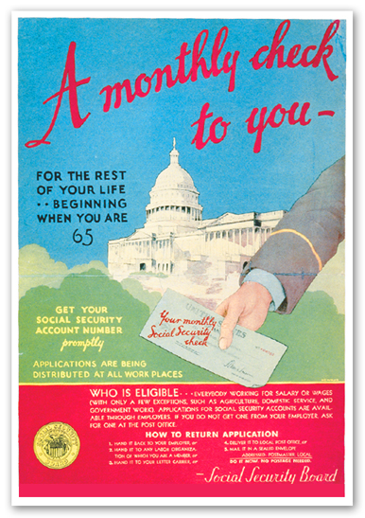
The Social Security Act created a pension system for retirees.
It also provided:
unemployment insurance
insurance for victims of work-related accidents
aid for poverty-stricken mothers and children, the blind, and the disabled

Slide 11
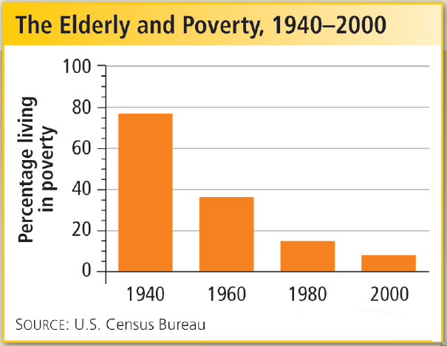
Such benefits helped reduce poverty among the nation’s elderly.
http://www.cbsnews.com/news/will-social-security-run-out-of-money/

Slide 12
Roosevelt believed that improving the standard of living for industrial workers would benefit the entire economy.
Recognized the right of workers to join labor unions
Gave workers the right to collective bargaining
Wagner Act
Set a minimum wage and maximum workweek
Outlawed child labor
Fair Labor Standards Act

Slide 13
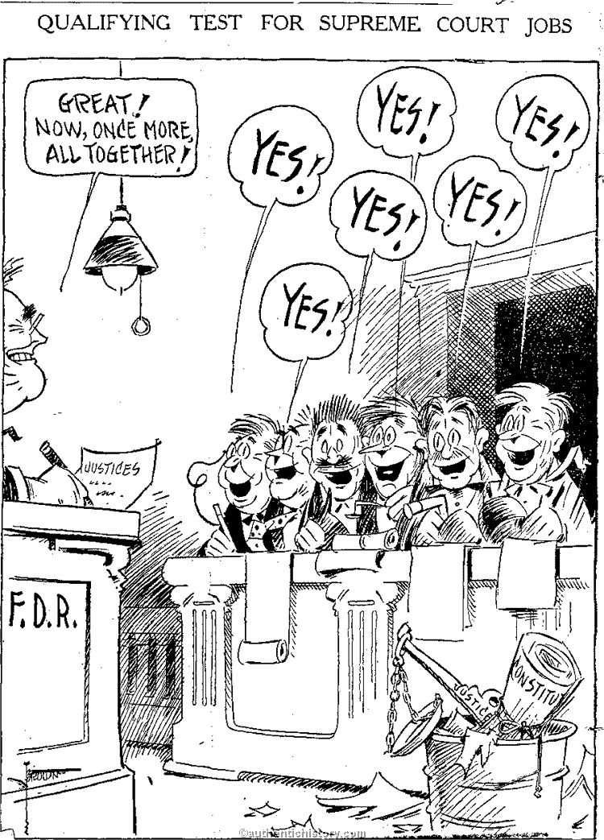
After an overwhelming reelection victory, FDR decided to fight back against the Supreme Court, which had struck down many of his programs.
In 1937, FDR proposed adding up to six new Justices to the Court.
Critics attacked his court-packing plan as an attempt to expand presidential power.
The failed plan weakened Roosevelt politically.

Slide 14
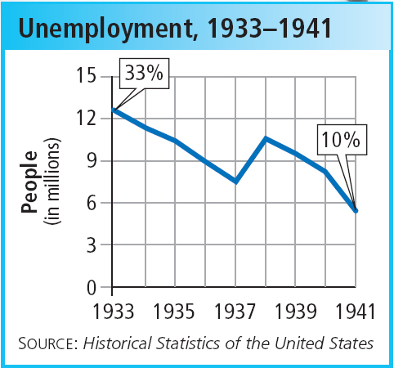
After the economy had begun to improve in 1935 and 1936, FDR cut back on government spending to reduce the deficit. At the same time, interest rates rose.
The combination caused the economy to sink again, and unemployment soared.
With his support wavering, FDR did not try to push further reforms through Congress.

