Slide 1
The Great War
1914-1918

Slide 2
Objectives
Identify the causes of World War I.
Describe the course and character of the war.
Explain why the United States entered the conflict on the side of the Allies.

Slide 3
Terms and People
Alsace-Lorraine – French region lost to German states in 1871
militarism – a glorification of the military
Francis Ferdinand – archduke of Austria-Hungary who was assassinated in 1914
William II – the German emperor
Western Front − trenches that stretched from the Belgian coast to the Swiss border with France, forming the battlefield between the Allies and the Central Powers in Western Europe

Slide 4
Terms and People
casualty – killed, wounded, or missing soldier
contraband – weapons and other war supplies
U-boat – a German submarine
Lusitania – English passenger ship sunk by a German U-boat, killing American civilians
Zimmermann note – a telegram in which the German foreign minister proposed an alliance with Mexico against the U.S.

Slide 5
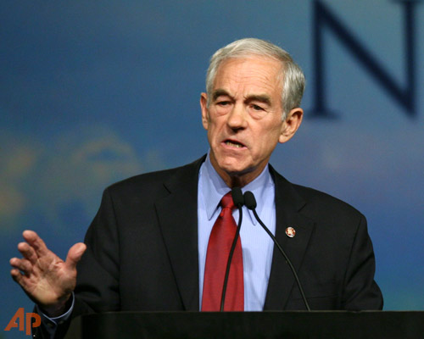
Should we follow this guy’s foreign policy?
http://www.youtube.com/watch?v=RQeAzx8mc7g

Slide 6
In 1914, six factors made Europe a powder keg ready to explode.
Nationalism
Militarism
Economic rivalries
Imperial ambitions
Regional tensions/old rivalries
Entangling alliances

Slide 7
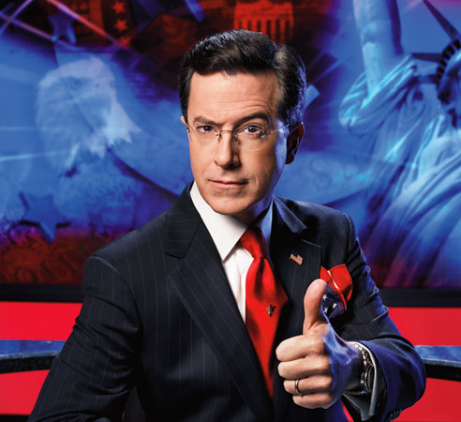
Nationalism, or devotion to one’s country, especially caused tensions to rise.
Among the powers of Europe, nationalism caused a desire to avenge perceived insults and past losses.
Some felt national identity centered around a single ethnic group and questioned the loyalty of ethnic minorities.
Social Darwinists applied the idea of “survival of the fittest” to nations.

Slide 8
Economic competition for trade and colonies increased nationalistic feelings.
Economic competition caused a demand for colonies and military bases in Africa, the Pacific islands, and China.
Alliances provided a promise of assistance that made some leaders reckless or overly aggressive.

Slide 9
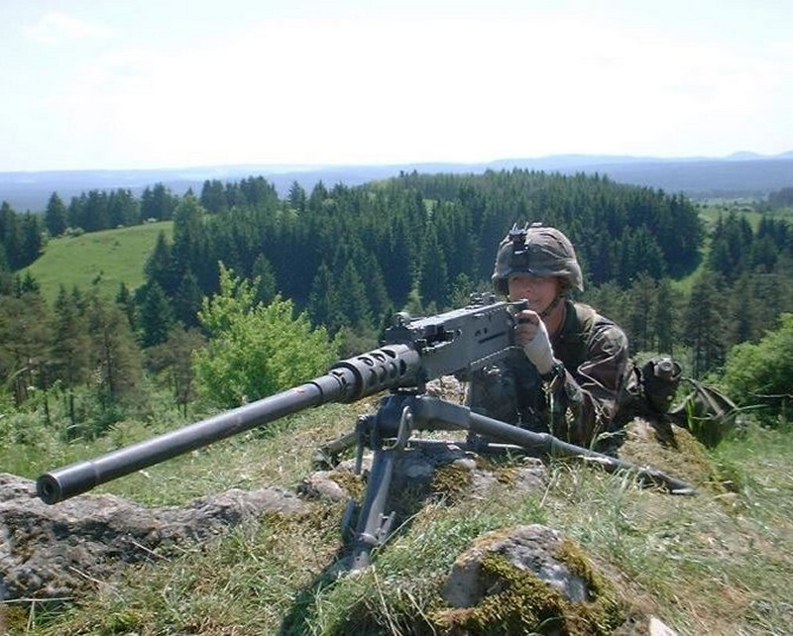
Protection of Investments
Militarism,
combined with nationalism, led to an arms race.
Nations stockpiled new technology, including machine guns, mobile artillery, tanks, submarines, and airplanes.

Slide 10
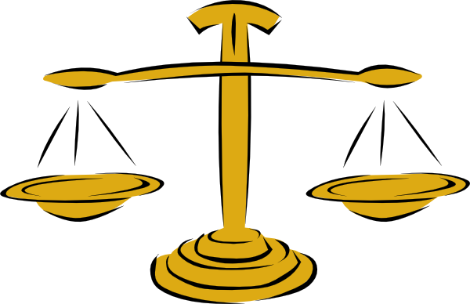
Balance of Power System
An international political system that insured that not one great power would dominate over the others.

Slide 12
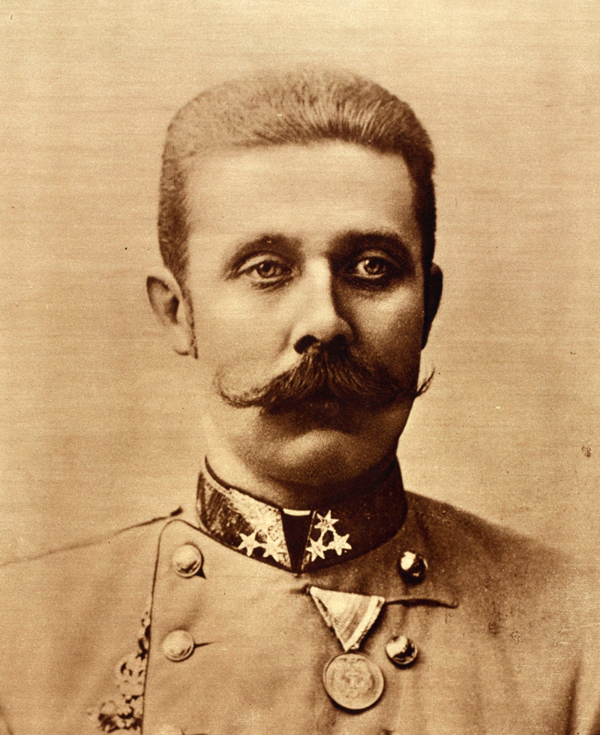
The Spark
On June 28, 1914, Serb nationalists assassinated the heir to the throne of Austria-Hungary, Archduke, Francis Ferdinand.

Slide 14
The Reaction
Austria-Hungary demands reparations from the smaller Serbian government.
Serbia attempted to meet most of them (to avoid further conflict) but couldn’t meet them all
Serbia looked to its ally Russia for support
Austria-Hungary looked to its ally Germany for support.
Germany gave Austria-Hungary a “Blank Check”

Slide 16
The Snowball Effect
Since Germany declared it would support A-H at all costs, it began to mobilize for war.
Troops were called up
Train systems were diverted
Tactical strategies were discussed

Slide 17
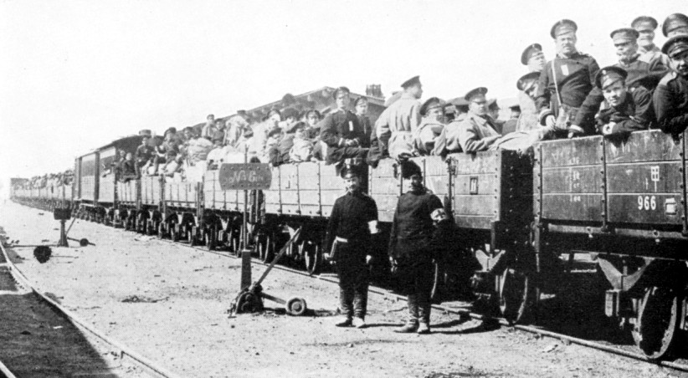
Russia saw Germany and began to mobilize as well
Since Russia and France had an alliance, France prepared for war as well
It looked as if once war preparations were started there was no way to stop the conflict

Slide 19
The Schlieffen Plan
Germany initiates their war plans
Attack France quickly through Belgium
Then move to take on Russia

Slide 20
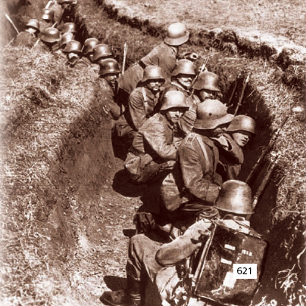
Germany invasion of Belgium, a neutral country, brought Britain into the war
The German advance was stopped about 30 miles from Paris.

Slide 21
Europe’s alliance system caused the conflict to spread quickly, creating two main combatants.
Allied Powers included Britain, France, Russia, and Serbia.
Central Powers included Germany and Austria-Hungary.

Slide 22
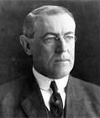
Neither side could overcome the other’s defenses, and a stalemate quickly developed.
As the war dragged on in Europe, President Wilson urged Americans to remain neutral.

Slide 23
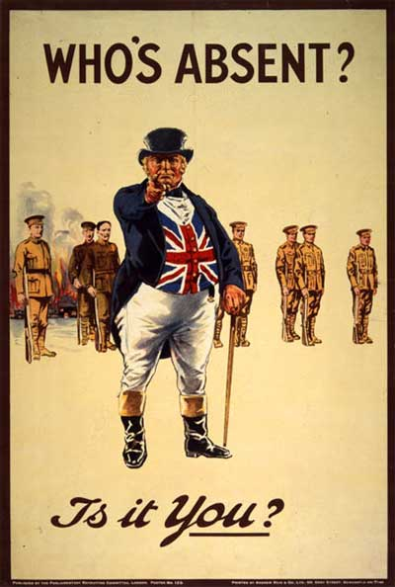
The United States had a long tradition of staying out of European conflicts.
Yet one-third of Americans had been born in a foreign country and still identified with their homelands.

Slide 24
Many Americans favored one side or the other.
U.S. public opinion fell into three main groups.
Isolationists | Favored staying out of the war
Interventionists | Favored fighting on the Allies’ side
Internationalists | Wanted the U.S. to play a role for peace but not fight

