Slide 1
The Great Society
The Johnson Administration

Slide 2
How did Johnson’s Great Society programs change life for most Americans?
President Johnson shared the goals President Kennedy had advanced.
He pushed important domestic legislation through Congress.

Slide 3
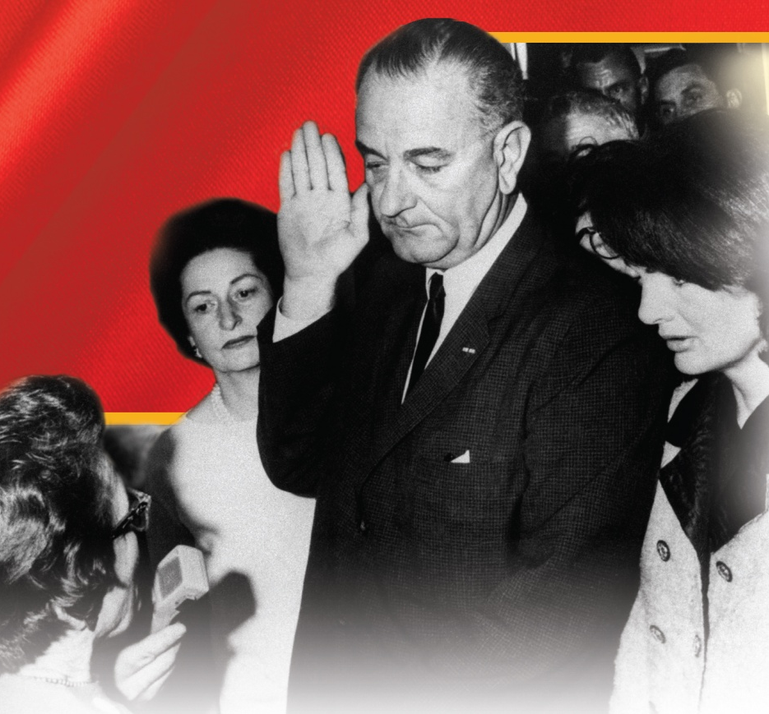
After Vice President Lyndon Johnson was sworn in as President, he worked for the same goals Kennedy had championed.
Johnson was a seasoned politician and good at bringing groups together
A prime example is when Congress is able to pass the Civil Rights Act of 1964.

Slide 4
The Civil Rights Act of 1964
outlawed discrimination in voting, education, and public accommodations established the Equal Employment Opportunity Commission to fight discrimination in hiring prohibited discrimination on the basis of a person’s sex in public accommodations and in hiring

Slide 5
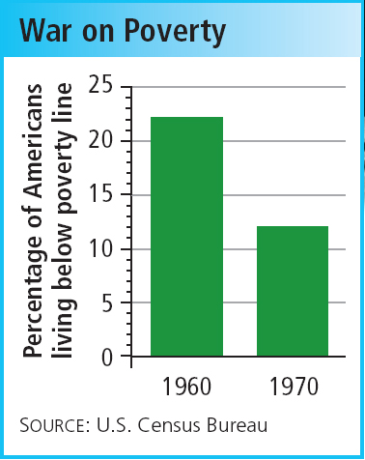
President Johnson convinced Congress to pass a big tax cut for the middle class.
He also established the War on Poverty to promote job training, education, and healthcare for those in need.

Slide 6
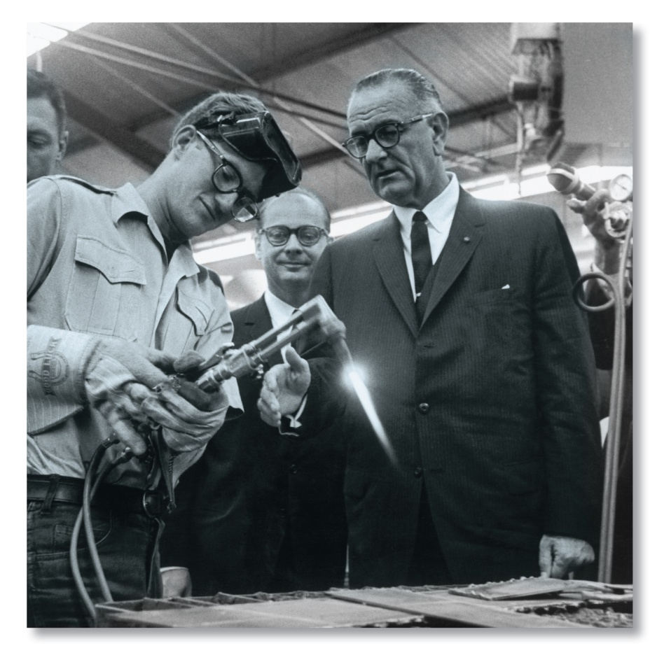
As part of the War on Poverty, the Economic Opportunity Act of 1964:
created the Job Corps to train young people in work skills
established VISTA to send volunteers into poor American communities
formed Project Head Start to fund preschool programs

Slide 7
In the 1964 presidential election, President Johnson defeated Barry Goldwater in a landslide.
Johnson used his popularity to call for a Great Society that would end poverty and racial injustice and provide opportunity for every child.

Slide 8
Johnson’s Great Society
created Medicare and Medicaid provided funds to impoverished school districts passed legislation to improve air and water quality passed the Immigration and Nationality Act of 1965 to lift immigration quotas created the National Endowment for the Arts and Humanities

Slide 9
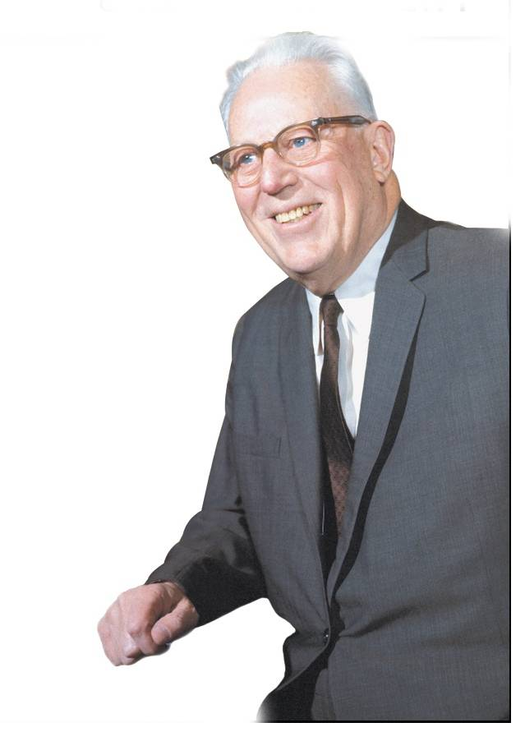
During Johnson’s presidency, the Supreme Court decided many cases involving controversial social, political, and religious issues.
Called the Warren Court after Chief Justice Earl Warren, the Supreme Court supported civil rights, civil liberties, voting rights, and personal privacy.

