Slide 1
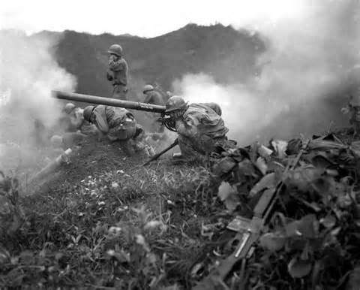
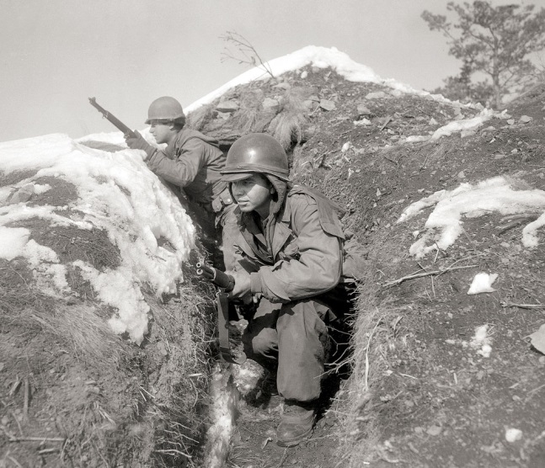
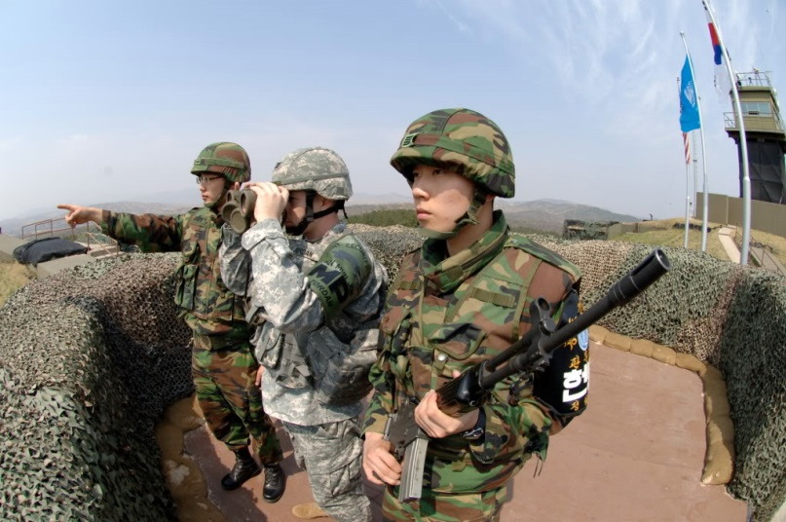
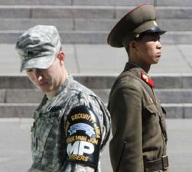
The “Forgotten War”
Korea

Slide 2
Vocabulary Words and Phrases
limited war − war fought to achieve only specific goals
38th parallel − dividing line between North Korea and South Korea

Slide 3
How does this relate to the Cold War?
In the early 1950s, Cold War tensions erupted in East Asia, where communist and non-communist forces struggled for control.
Before World War II, China had been torn apart by a brutal civil war.
Pro-government Nationalists
Communist revolutionaries
Led by Jiang Jieshi
Supported by the United States
Led by Mao Zedong
Supported by the Soviet Union

Slide 4
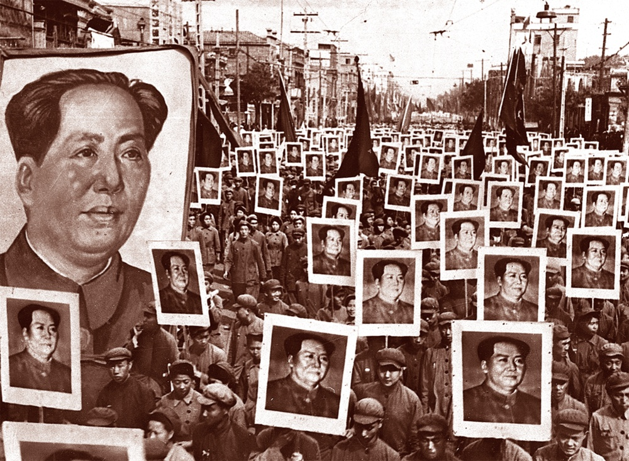
Mao built support by promising food to the starving population. Communist forces soon dominated.
Despite U.S. aid, Jiang’s government faltered.
Nationalist generals were reluctant to fight.
Corruption was rampant.
Mao took control of the mainland, renaming it the People’s Republic of China.

Slide 5
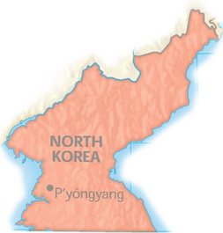
The next battleground was on the Korean peninsula.
North Korea
The Soviet Union supported North Korea and established a communist government there.
After World War II, Korea was divided into two countries along the 38th parallel.
South Korea
The United States provided aid to noncommunist South Korea.

Slide 6
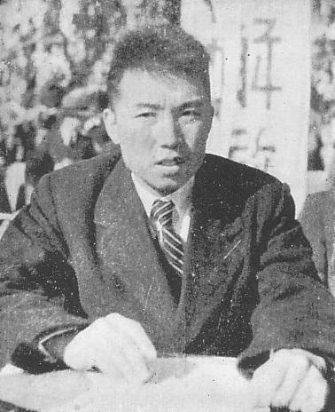
The crisis began in June, 1950.
North Korean troops, armed with Soviet equipment, crossed the 38th parallel and attacked South Korea.
Communist forces advanced far into the South, taking over much of the peninsula.
Kim-Il Sung
Communist Leader of North

Slide 7
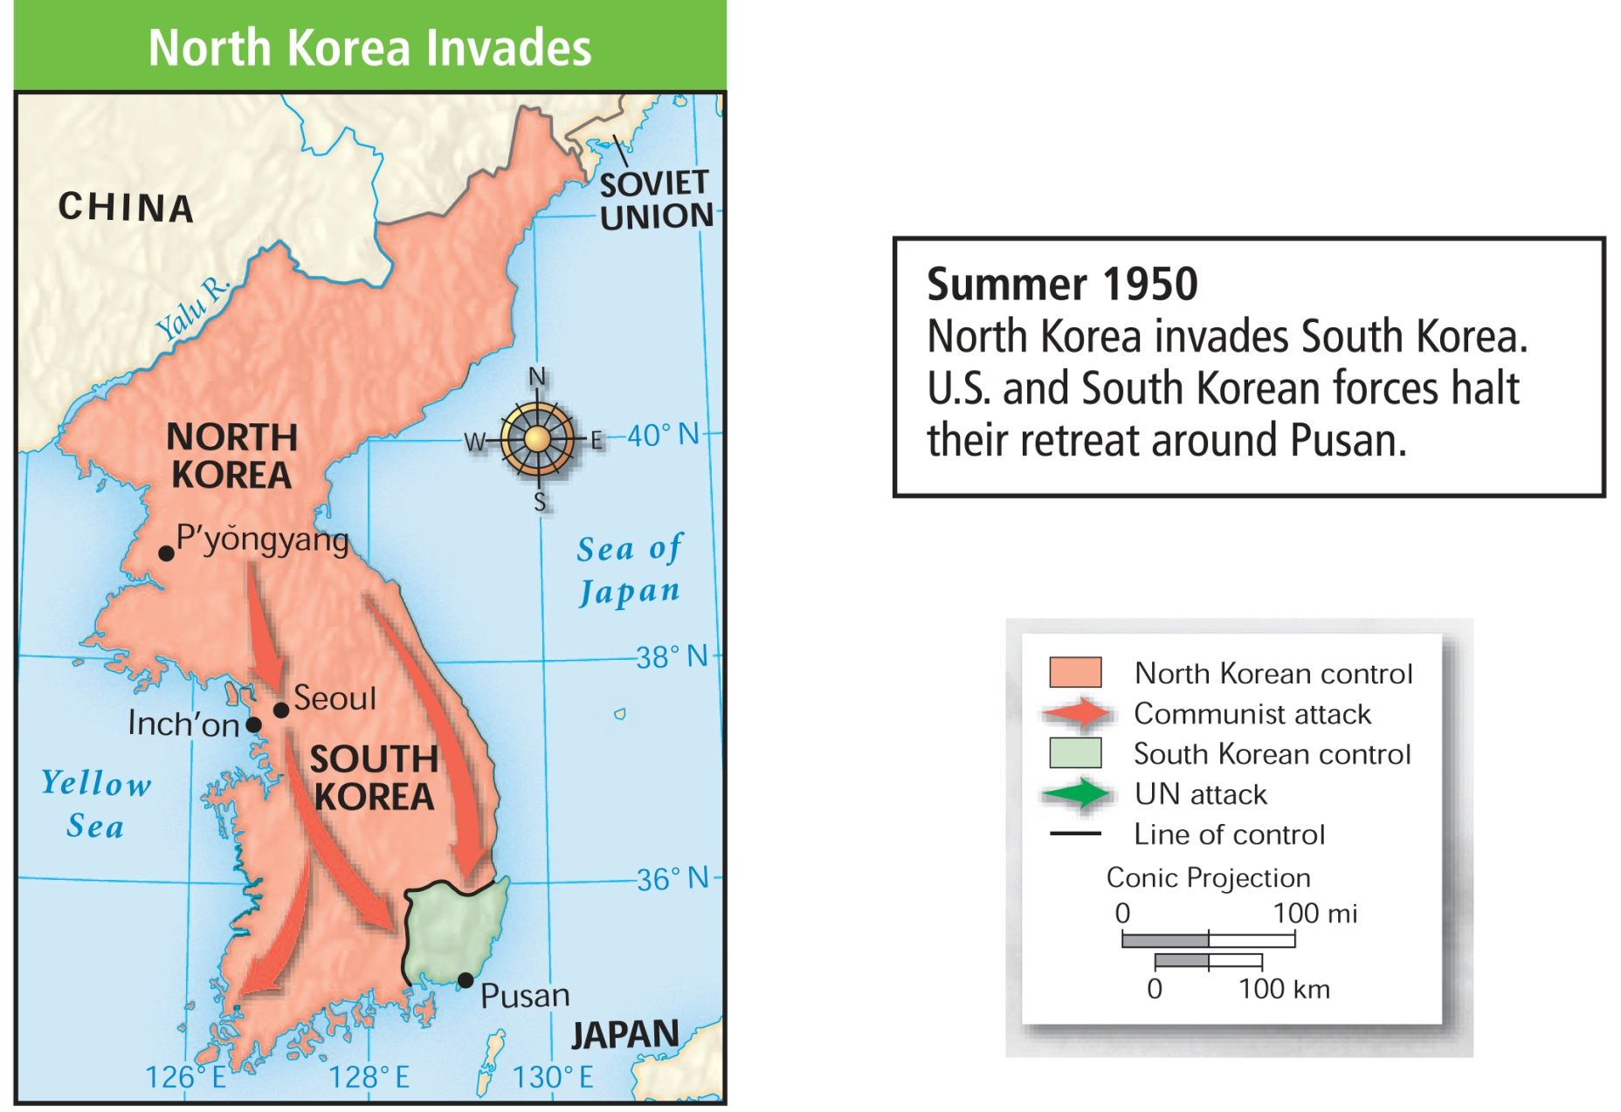
Forces from the U.S. and other UN countries arrived to help their South Korean allies.
They halted their retreat near Pusan.

Slide 8
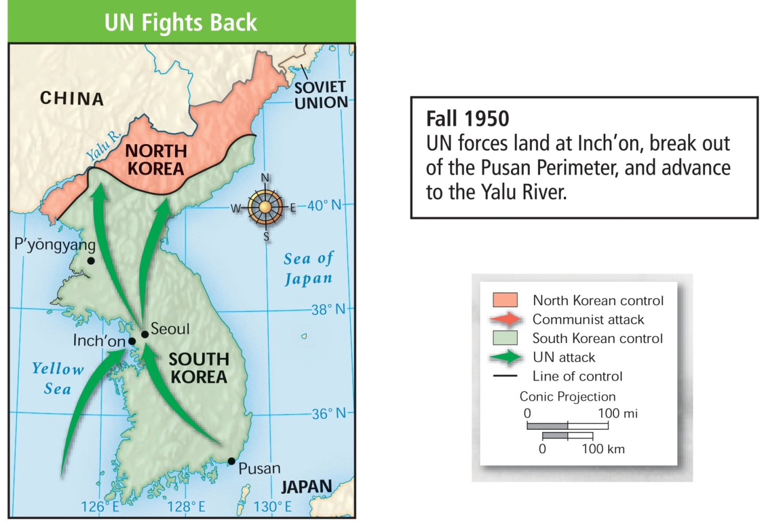
Gen. Douglas MacArthur devised a bold counterattack designed to drive the invaders from South Korea.
It is successful, but…

Slide 9
The situation worsened when China entered the war, sending 300,000 troops across the border into North Korea.
The Chinese attacked U.S. and South Korean positions.
Badly outnumbered, UN troops were forced to retreat.
During the winter of 1950 and 1951, communist forces pushed UN troops to the 37th parallel.

Slide 10
Now what does the U.S do?
The U.S. now faced the possibility of all-out war against the world’s most populous nation.
Truman refused. He favored a limited war to help stabilize South Korea.
MacArthur favored invading China to win a total victory.

Slide 11
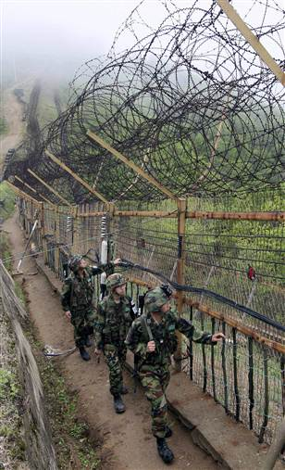
By the spring of 1951, UN forces secured their position near the 38th parallel, and a tense stalemate began.
In 1953, the two sides agreed to a cease-fire. This agreement remains in effect today.
http://upload.wikimedia.org/wikipedia/commons/e/eb/Korean_war_1950-1953.gif

