Slide 1
Introduction to the Cold War

Slide 2
Objectives
Trace the reasons that the wartime alliance between the United States and the Soviet Union unraveled.
Explain how President Truman responded to Soviet domination of Eastern Europe.
Describe the causes and results of Stalin’s blockade of Berlin.

Slide 3
Vocabulary Words and Phrases
satellite state − small country controlled by a more powerful neighbor
Cold War − struggle in which the U.S. and Soviet Union became rivals but never fought directly in military conflict
iron curtain − imaginary barrier separating Soviet-controlled countries and the free world
Truman Doctrine − President Truman’s policy to aid nations struggling against communism
George F. Kennan − American diplomat and leading authority on the Soviet Union

Slide 4
Vocabulary Words and Phrases
containment − American policy to keep communism contained within its existing borders
Marshall Plan − U.S. aid program to help Western Europe rebuild after World War II
Berlin airlift − operation in which the U.S. and Britain broke the Soviet blockade of West Berlin
NATO − North Atlantic Treaty Organization; military alliance to counter Soviet expansion
Warsaw Pact − rival military alliance formed by the Soviet Union and its satellite states

Slide 5
How did U.S. leaders respond to the threat of Soviet expansion in Europe?
World War II convinced U.S. leaders that the policies of isolationism and appeasement had been mistakes.
To counter the growing Soviet threat, they sought new ways to keep the U.S. safe and protect its interests abroad.

Slide 6
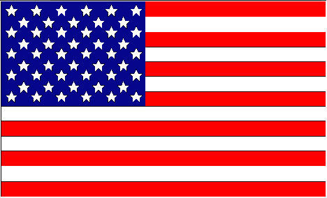
Despite their alliance during World War II, the U.S. and the Soviet Union had little in common.
The United States was a capitalist democracy. The American people valued freedom and individual rights.
The Soviet Union was a dictatorship. Stalin and the Communist Party wielded total control over the lives of the Soviet people.

Slide 7
These differences were apparent as the Allies made decisions about the future of postwar Europe.
Postwar Goals
U.S. and Britain | U.S.S.R.
Strong, united Germany | Weak, divided Germany
Independence for nations of Eastern Europe | Maintain Soviet control of Eastern Europe

Slide 8
When the Big Three met at Yalta, Stalin agreed to allow free elections in Eastern Europe, yet free elections were not held.
When the Big Three met again at Potsdam, the U.S. and Britain pressed Stalin to confirm his commitment to free elections; Stalin refused.
The Big Three alliance crumbled.

Slide 9
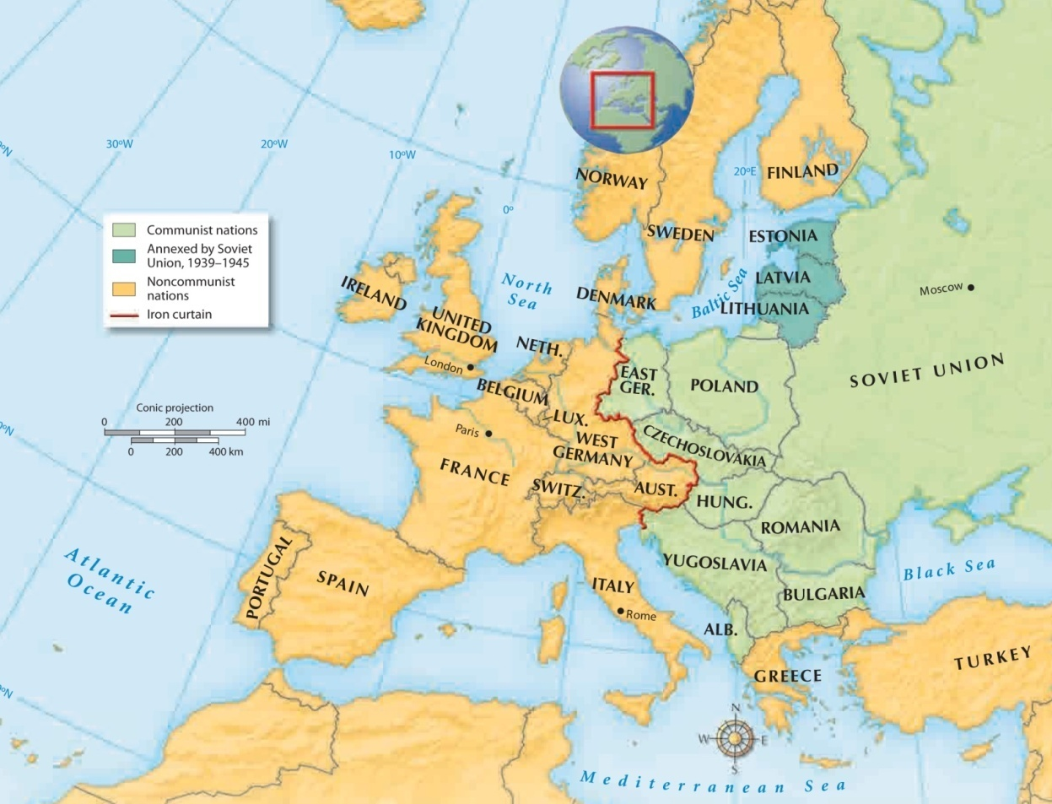
The nations of Eastern Europe and the eastern part of Germany became satellite states of the Soviet Union, separated from the free world by an “iron curtain.”

Slide 10
After the Big Three split at Potsdam, the Cold War struggle between the world’s two superpowers began.
The Soviets were determined to spread communism to other lands.
The Americans were determined to stop the spread of totalitarian ideas.
Communist expansion became the United States’ top concern.

Slide 11
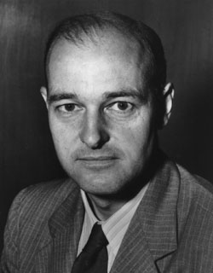
George Kennan and Containment
July 1947, and article in Foreign Affairs appears authored by “X”
“the main element of any United States policy toward the Soviet Union must be that of a long-term patient but firm and vigilant containment of Russian expansive tendencies.”
This becomes the basis for Containment and what will later become an ABC foreign policy
-American Scholar and Diplomat
-Ambassador to the Soviet Union

Slide 12
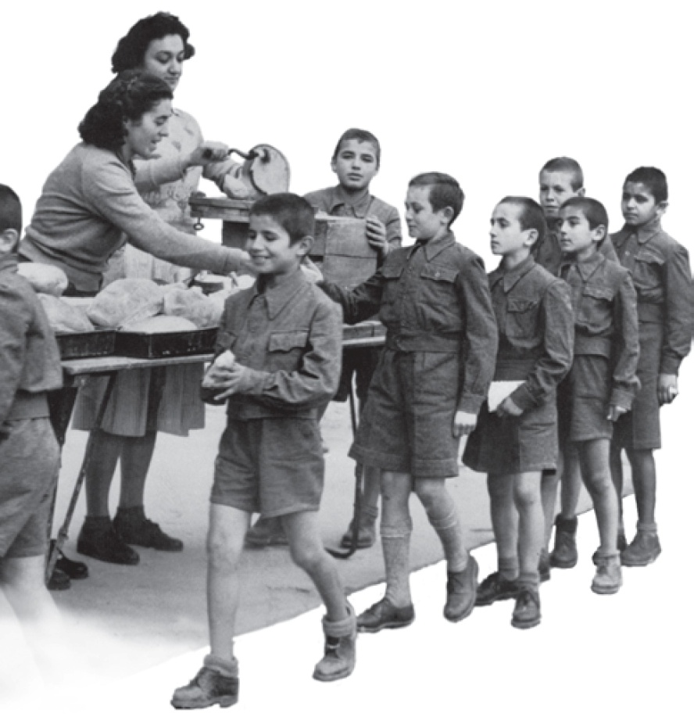
With the Truman Doctrine, the U.S. promised to support nations struggling against communist movements.
Money was sent to Greece and Turkey to provide aid to people who needed it.

Slide 13
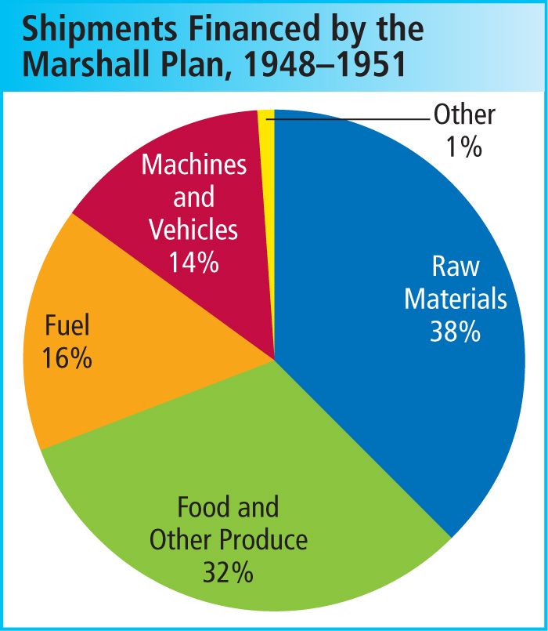
The U.S. sent about $13 billion to Western Europe under the Marshall Plan.
The money provided food, fuel, and raw materials to help rebuild war-torn cities and towns.

Slide 14
Germany, and the city of Berlin, became flashpoints in the Cold War.
After the war, Germany was divided into four zones.
The zones controlled by the U.S., Britain, and France were combined to form West Germany.
The Soviet zone became East Germany.

Slide 15
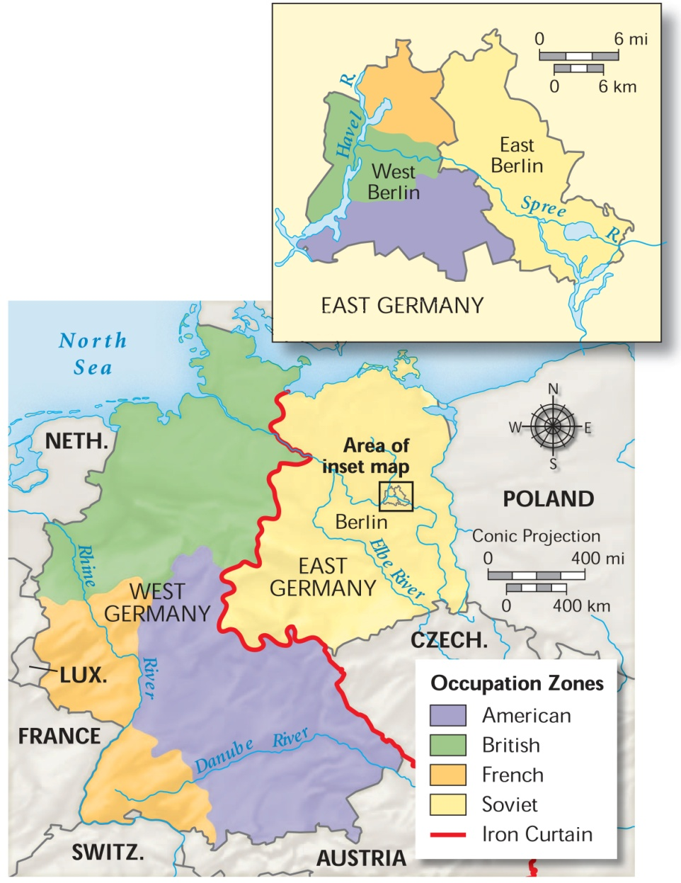
Berlin was also divided.

Slide 16
West Berlin was controlled by the Allies.
The prosperity and freedoms there stood in stark contrast to the bleak life in communist East Berlin.
Determined to capture West Berlin, Stalin blockaded the city, cutting off supplies.
In response, the U.S. and Britain sent aid to West Berlin through a massive airlift.

Slide 17
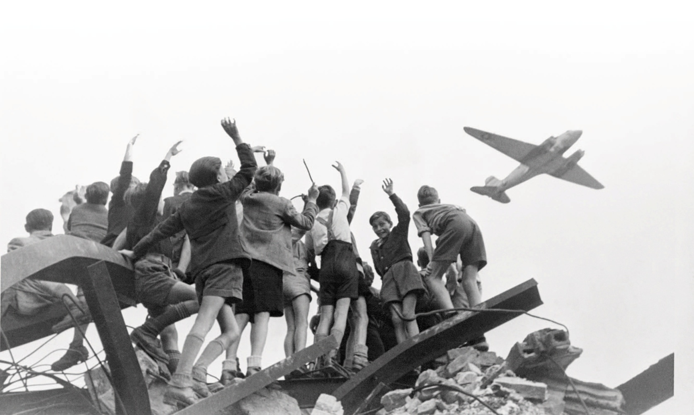
The Berlin airlift saved West Berlin and underscored the U.S. commitment to contain communism.

Slide 18
As Cold War tensions mounted, both sides formed military alliances for collective security.
NATO | Warsaw Pact
Belgium Netherlands Canada Norway Denmark Portugal France Turkey Greece United Kingdom Iceland United States Italy West Germany Luxembourg | Albania Bulgaria Czechoslovakia East Germany Hungary Poland Romania Soviet Union

