Slide 1
Into the Fray:
America at War

Slide 2
Objectives
Explain why Japan decided to attack Pearl Harbor, and describe the attack itself.
Outline how the United States mobilized for war after the attack on Pearl Harbor.
Summarize the course of the war in the Pacific through the summer of 1942.

Slide 3
Vocabulary Terms and Phrases
Pearl Harbor − site in Hawaii of the United States Navy’s main Pacific base

Slide 4
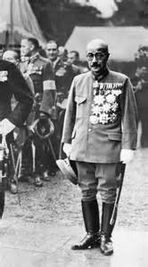
Tensions mounted as Japan continued its march into new lands, gaining territory and valuable natural resources.
Roosevelt condemned Japanese aggression.
He worked to slow Japan’s expansion with an embargo.
Angered by American interference, Prime Minister Hideki Tojo decided it was time to eliminate the U.S. presence in the Pacific.

Slide 5
December 7th 1941
https://www.youtube.com/watch?v=yMrrflkfyns
https://www.youtube.com/watch?v=kMa0LNnI-iA

Slide 6
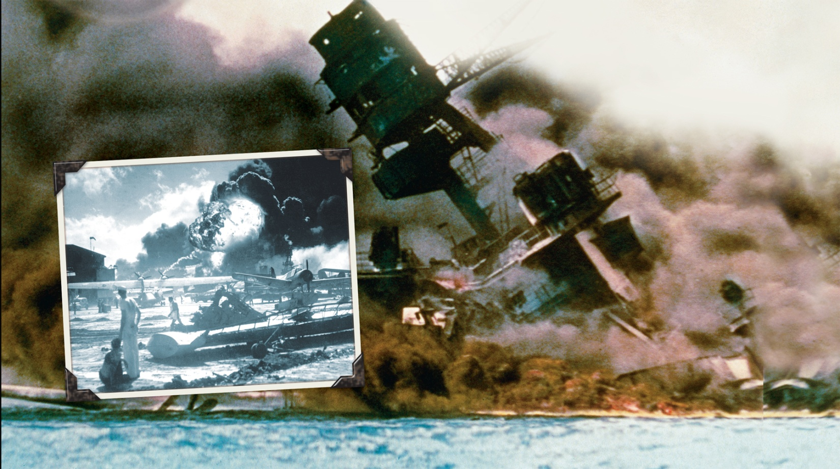
On December 7, 1941, Japanese fighter pilots attacked the American naval base at Pearl Harbor, Hawaii.

Slide 7
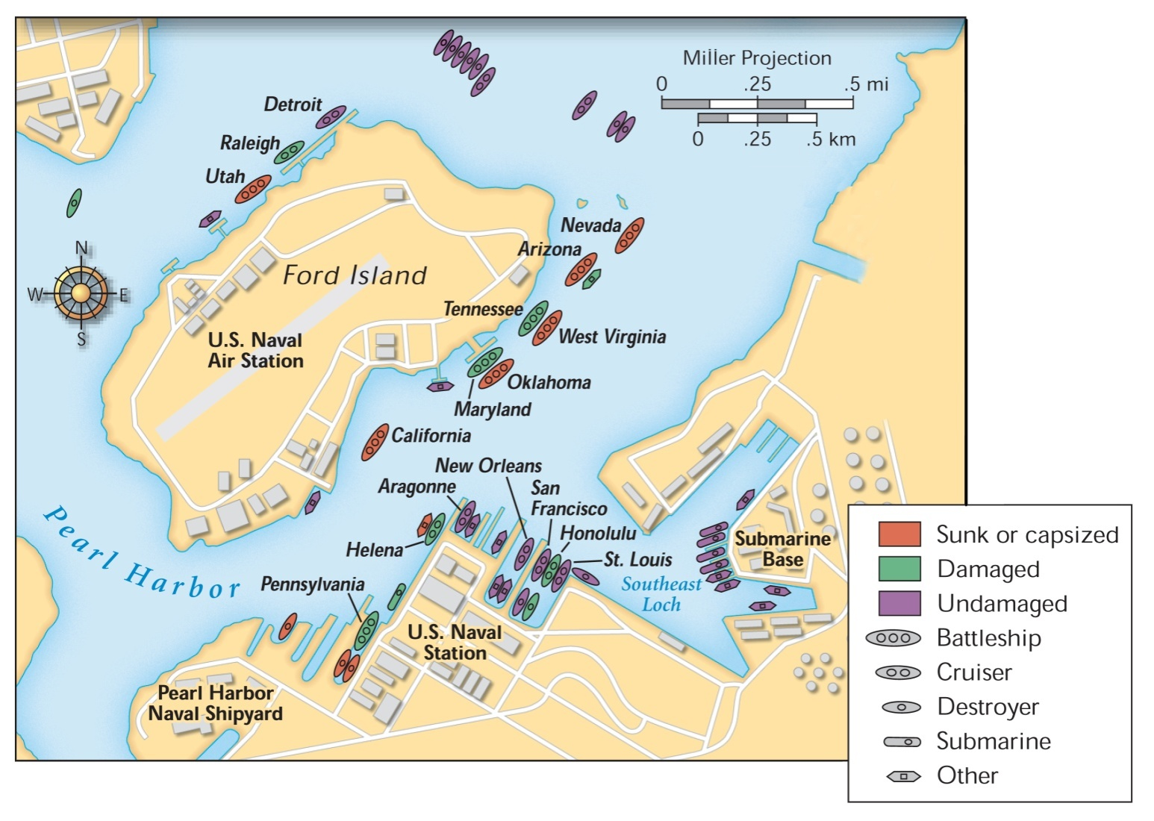
Damage at Pearl Harbor

Slide 8
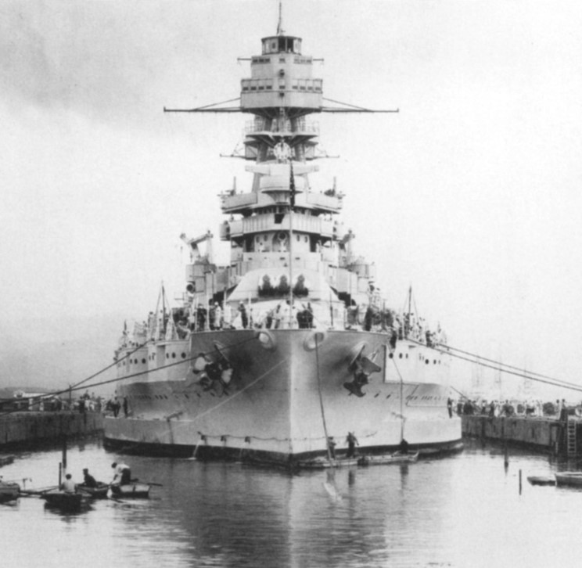

Slide 9
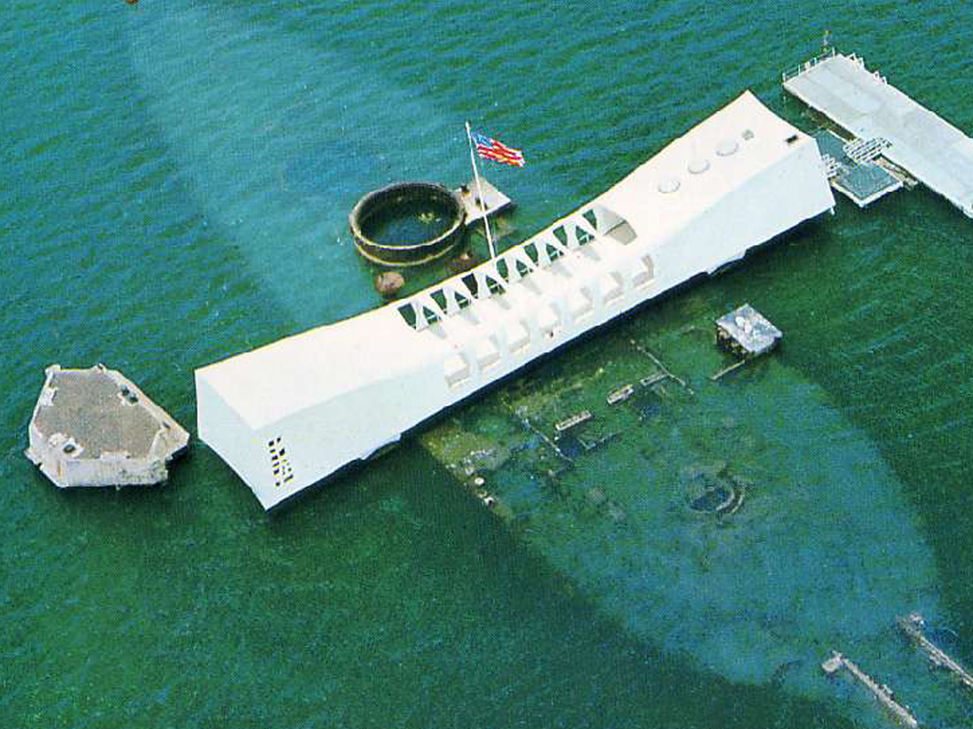
https://www.youtube.com/watch?v=21w1eMUmEaU

Slide 10
After the attack, the United States declared war on Japan.
Japan’s allies, Germany and Italy, then declared war on the United States.
https://www.youtube.com/watch?v=lK8gYGg0dkE

Slide 11
A wave of patriotism swept the United States following the attack.
Americans joined the military, the Red Cross, and other organizations.
Women responded by joining the Women’s Army Corps, Army Nurse Corps, and other military auxiliaries.
Americans took new jobs making weapons and supplies that supported the war effort.

Slide 12
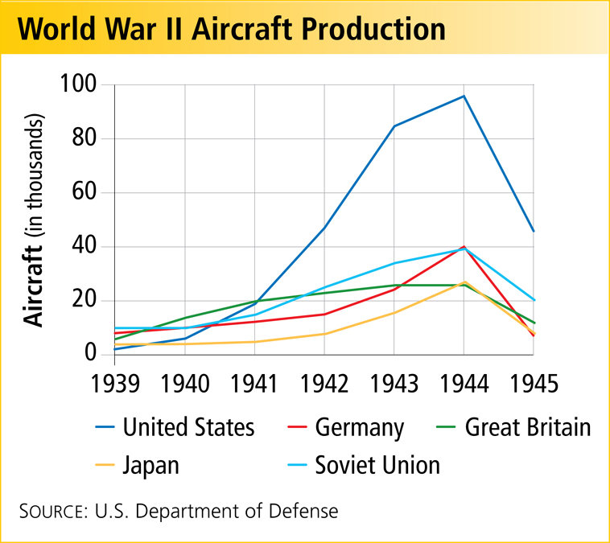
The money poured into defense spending finally ended the Great Depression.
American workers could once again find jobs.

Slide 13
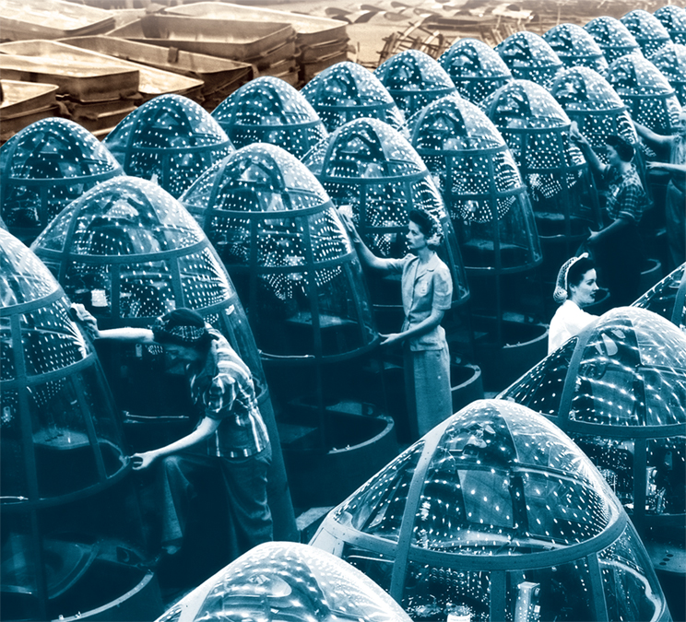
The peacetime economy soon shifted to a wartime economy.
Companies that once produced consumer goods mobilized to build ships, planes, and tanks.

Slide 14
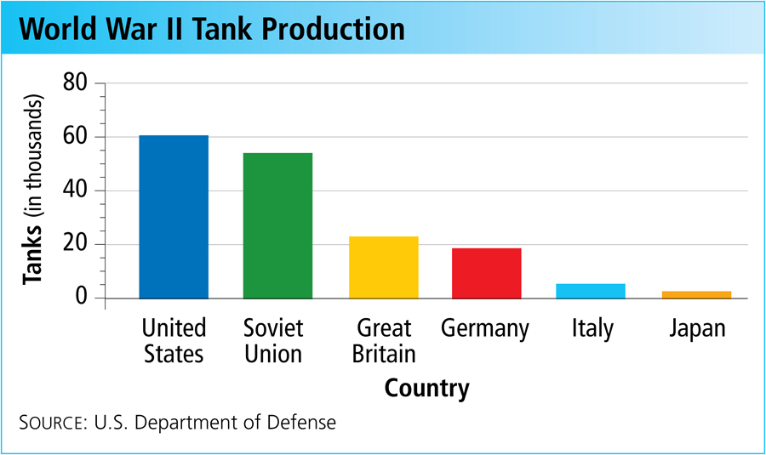
In 1944, American production levels were double those of all the Axis nations combined.
This “production miracle” gave the Allies a crucial advantage.

Slide 15
In the early years of the war, the outlook for the Allies was grim.
Japan’s Advantages
Dominance of the Pacific
Technologically advanced weapons
Highly motivated and well-trained military

Slide 16
Japanese armies quickly took Guam, Wake Island, and Hong Kong.
Then they moved into the Philippines, forcing American General Douglas MacArthur to retreat.
The troops were surrounded, trapped.
After a terrible siege, thousands died when they were forced to walk to prison camps during the Bataan Death March.
http://www.bataanmarch.com/default.htm

Slide 17
