Slide 1
Constitutional Change by Other Means
Ch 3 Sec 3

Slide 2
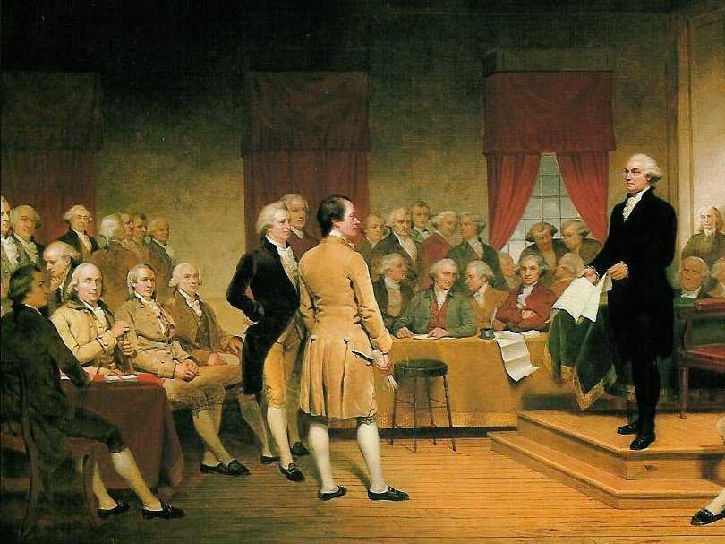
Why have anything other than formal methods?
Day to day operations gives governmental officials experiences in which can help them govern
Additionally the formal process is lengthy and difficult; politics can get in the way

Slide 3
Methods of Informal Change
There are five (5) key ways informal change can occur:
Passage of basic legislation
Actions of the President
Supreme Court decision
Activities of political parties
Customs

Slide 4
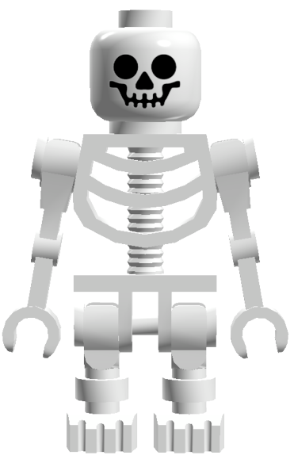
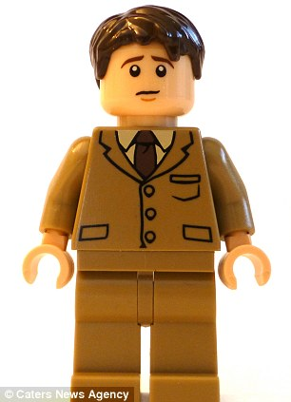
Basic Legislation
Congress has used its power as the law making body to flesh out skeletal aspects of the constitution. (i.e. Article II and Article III)
http://www.washingtonpost.com/blogs/govbeat/wp/2013/10/20/the-presidential-order-of-succession/
Additionally, it more clearly defines its Constitutional powers

Slide 5
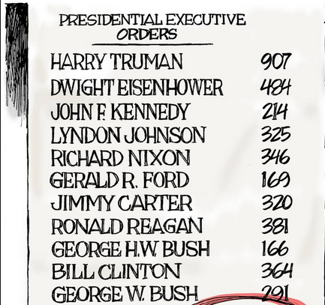
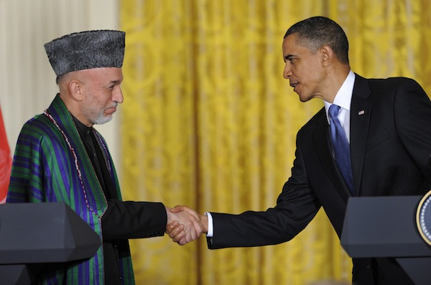
Executive Action
The manner in which Presidents wield their power also informally changes the constitution (i.e. executive agreement v treaty)
Much like Congress clarifying its Constitutional powers, Presidents do the same.

Slide 6
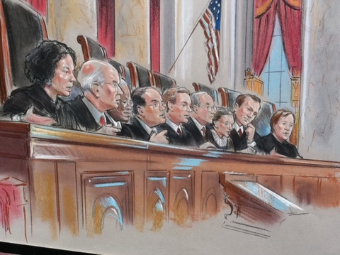
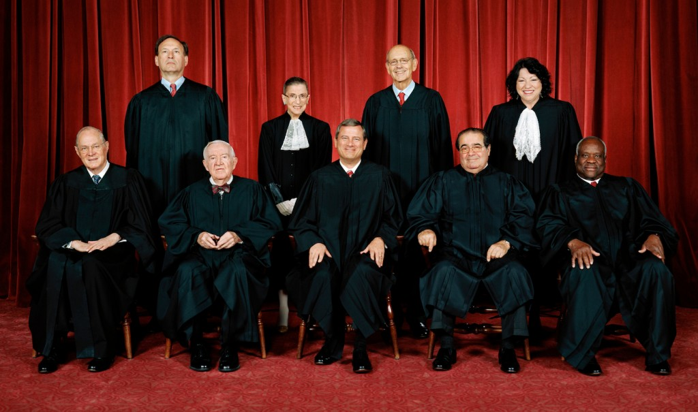
Court Decisions
As Woodrow Wilson said it best, “the Supreme Court is a constitutional convention in continuous session”
The Courts are constantly redefining the Constitution with each and every ruling.
They can interpret things to over-magnify or under-represent pieces of the document

Slide 7
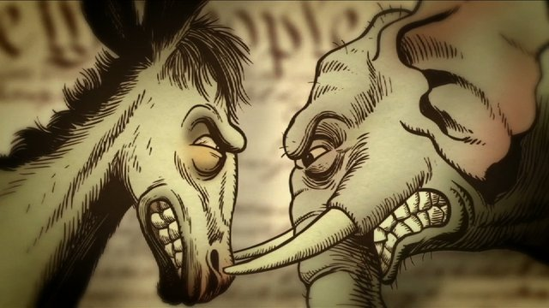
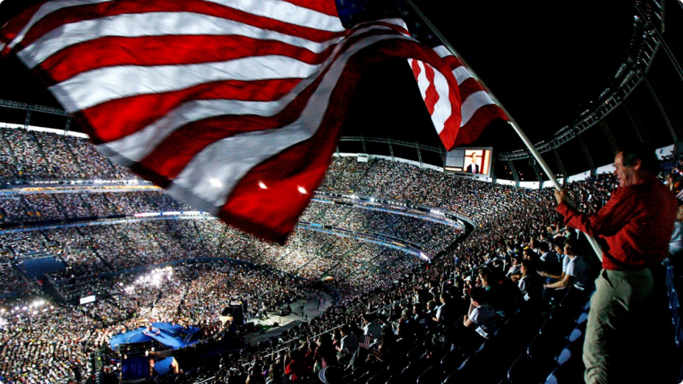
Political Parties
Responsible for making the Electoral College into a “Rubber Stamp”
No Law requires a nomination of candidates, yet we have huge conventions on election years to do just that.
Political parties also dominate daily politics in Congress and Executive appointments hinge on these affiliations

Slide 8
Custom
Unwritten rules have great power as well
Examples?
The Cabinet
The invoking the principle of the 25th amendment prior to its actual establishment
Senatorial Courtesy
3rd Terms as president until the 22nd amendment

